Slide 1
Spring Data introduction

Slide 2
Disclaimer
The opinions expressed in this presentation and on the following slides are solely those of the presenter and not necessarily those of Rusoft. Rusoft does not guarantee the accuracy or reliability of the information provided herein.

Slide 3
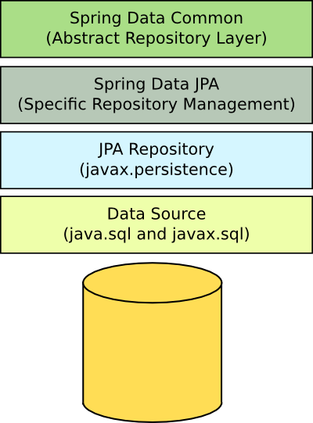
Spring Data

Slide 4
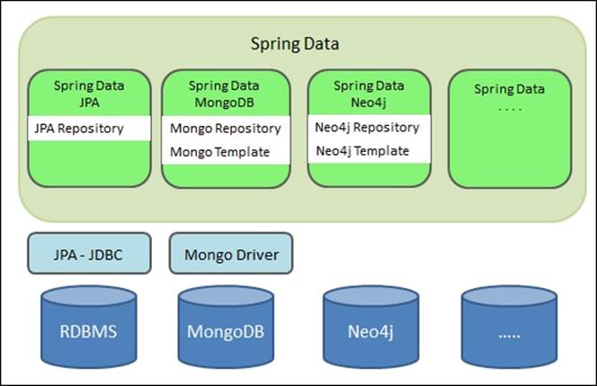
Spring Data

Slide 5
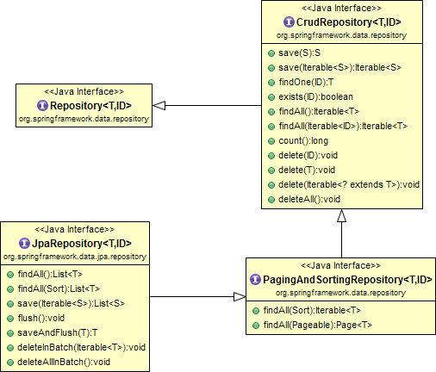
Spring Data

Slide 6
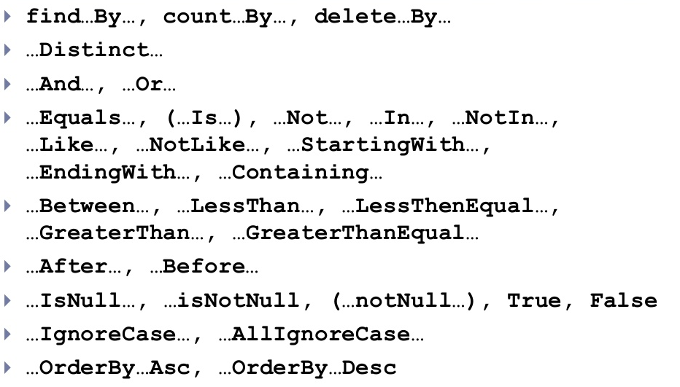
Defining query methods

Slide 7
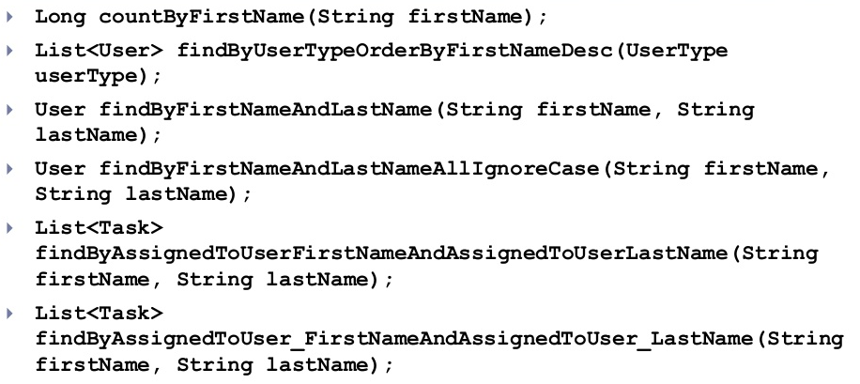
Defining query methods

Slide 8


Slide 9


